Slide 1
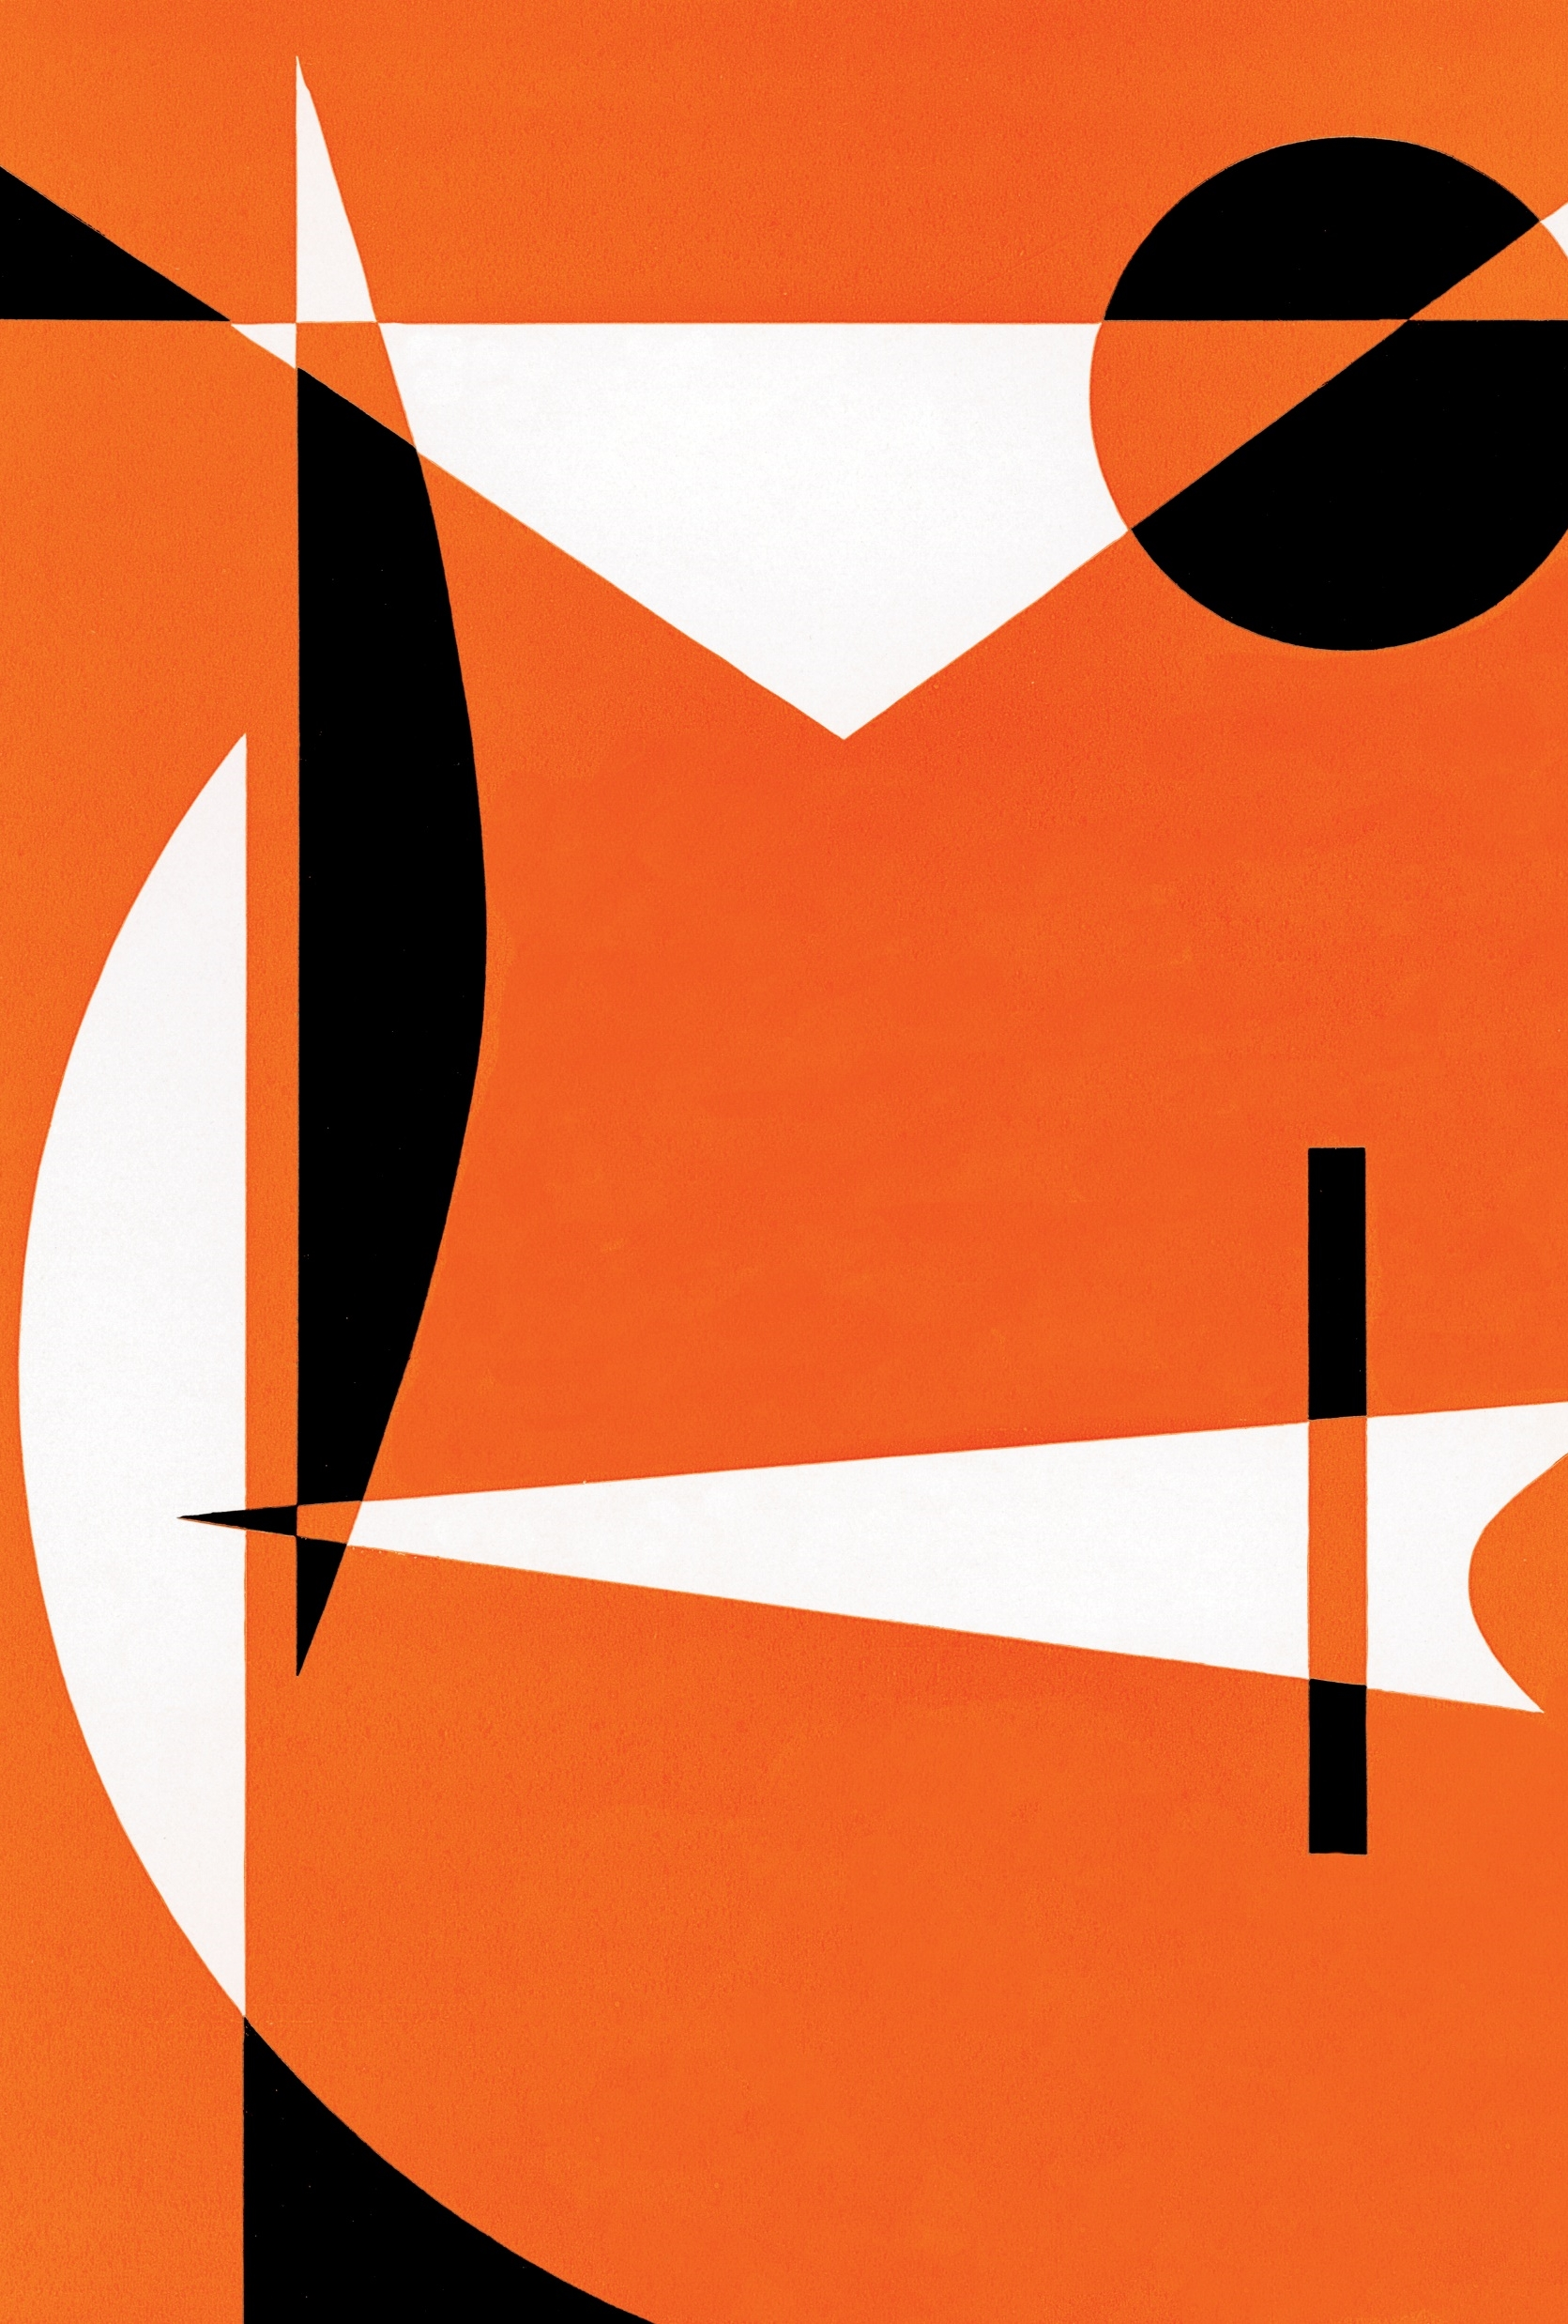
Maze Generation and solving Algorithm
By: Ibrahim al-kotob
Tamer kobba
Lama al sheikh

Slide 2
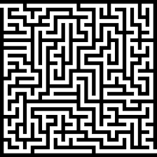
What is maze generation?

Slide 3
Sequential Approach

Slide 4
Algorithms used to solve it
Maze Generation(Kruskal’s)
Maze Searching and Solving (A*)

Slide 5
Maze Generation Algorithm
Sequential Approach
We are using Matrix to create a maze
Every 1 is a wall
Every 0 is a path

Slide 6
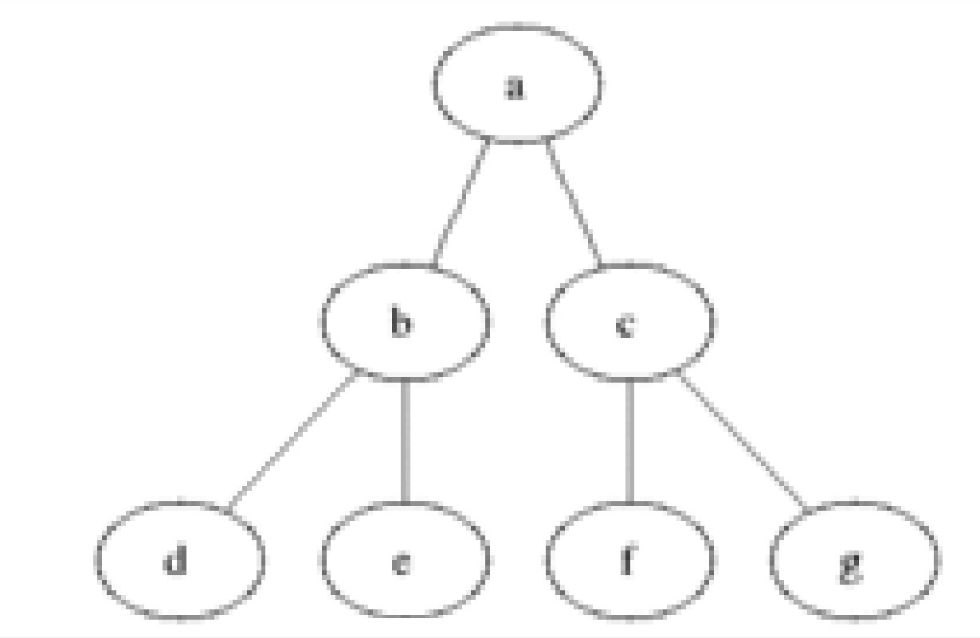
Maze Solving Algorithm: Sequential approach

Slide 7
Sequential Approach Solver
Of the four algorithms that are used to solve this problem - BFS, DFS, Dijkstra's and A* - three of them (BFS, Dijkstra's, and A*) are designed to find the shortest paths in structures where there are multiple different paths available and you're interested in finding the shortest. In that sense, running BFS, Dijkstra's, and A* will all, in some sense, incur a cost overhead because you're paying for something you aren't using. Dijkstra's algorithm, in particular, should perform no better than BFS in this case. Taking any step will cost you the same amount, and the cost of maintaining a priority queue or some other structure to find the lowest-cost node in the frontier will likely cost more than a standard queue. In that sense, we can probably rule out Dijkstra's as a candidate for the fastest algorithm here.

Slide 8
That leaves us BFS, A*, and DFS. Let's first compare BFS and DFS.BFS expands outward from the starting location by exploring paths of progressively longer and longer lengths if there were no obstacles, you'd expect BFS to visit some constant fraction of the total spaces in the maze before finding the exit, and with obstacles present it likely to explore most, if not all, of the spaces. DFS stops as soon as it finds the exit, and it's likely to explore lots of dead ends along the way, so there's similarly a good chance that it'll explore a large fraction of the maze cells. Given the choice between the two, my bet is that DFS would be slightly faster since generally speaking the constant factor for DFS is less likely to explore most of the maze before finding the exit. Then there's DFS versus A*. That's a harder one to analyze.

Slide 9
DFS is generally speaking a much faster algorithm than A* because of the associated overhead of maintaining distances in A*, but A* tends to search in directions that are much more likely to get you to the destination. It would probably depend on the shape of the maze. If the maze was constructed in a way that has a lot of long, twisty passageways, then A* would probably do better because it would avoid going the wrong direction until it absolutely had to, whereas DFS might spend lots of effort descending the wrong way. So we decided to choose A* to solve the maze instead just to avoid the worst case of DFS spending lots of effort descending the wrong way.

Slide 10
Parallel Approach

Slide 11
Parallelize Kruskal's algorithm:
Kruskal's algorithm generates the maze by randomly selecting edges and adding them to the maze, while ensuring that no cycles are formed. You can parallelize this process by partitioning the edges into multiple sets and processing each set in parallel. Once each set has been processed, you can merge the resulting mazes together. This approach can be efficient if the number of edges is very large.

Slide 12
Parallelize A* algorithm:
The A* algorithm finds the shortest path from the start to the end of the maze by exploring the maze using a heuristic function. You can parallelize this process by dividing the maze into multiple regions and processing each region in parallel. Each region can be explored using its own instance of the A* algorithm, and the resulting paths can be combined to find the shortest path through the entire maze.

Slide 13
How we divide the work?
Lama will do the a* parallelizing.
Ibrahim will do the Kruskal parallelizing.
Tamer will combine both approaches and test it.

Slide 14
References:

